Slide 1
Structured Programming Language CSE113

Slide 2
The Evolution of Electronic Computing
Communication
became
Free !!
Storage
became
Free !!
Computation
became
Free !!
1980
1990
2000
2020

Slide 3
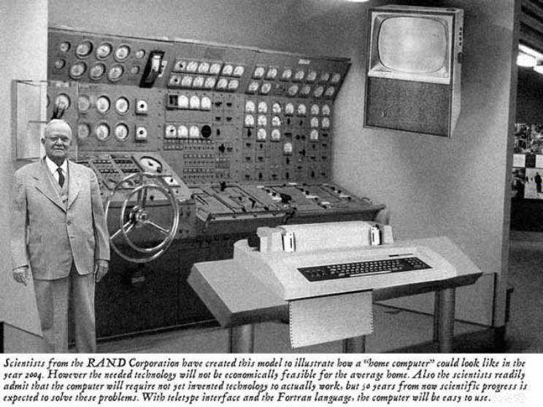
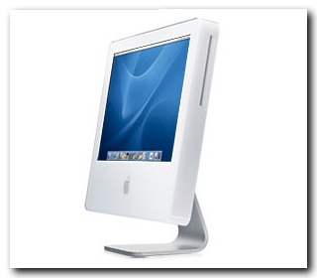
Home Computer @ 2015: Predicted versus Real
Predicted in 1954
Reality

Slide 4
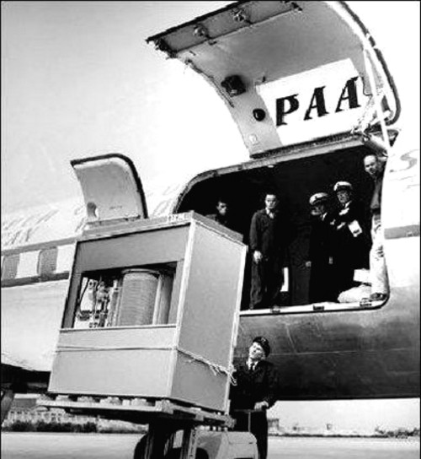
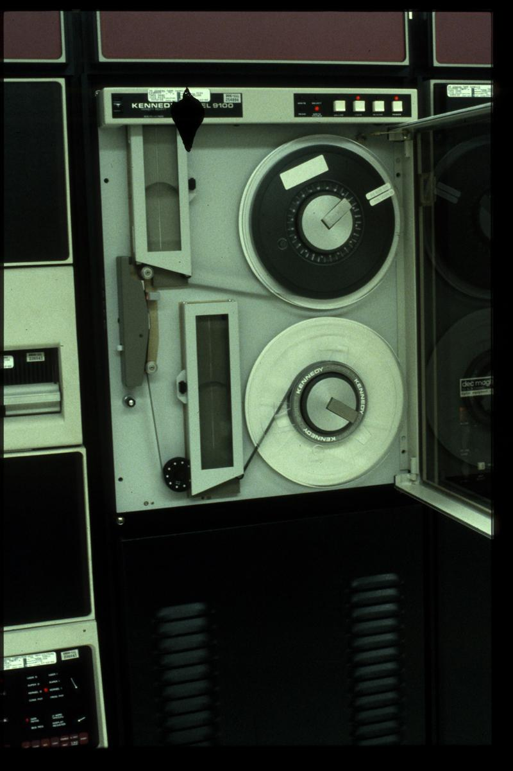
Storage has become free!!
Magnetic Tape Drive
8 GB Pen Drive
5 MB Hard Disk [1956]

Slide 5
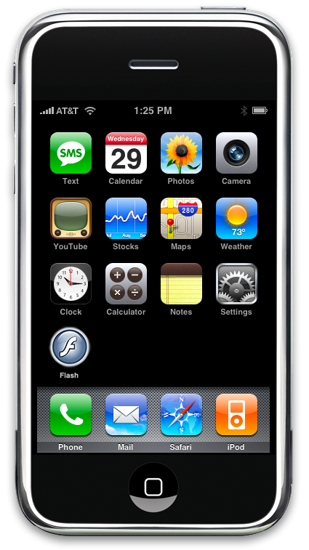
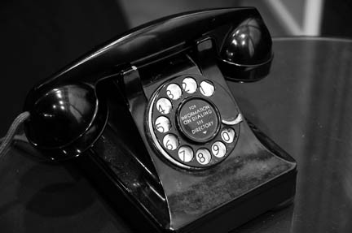
Communication??

Slide 6
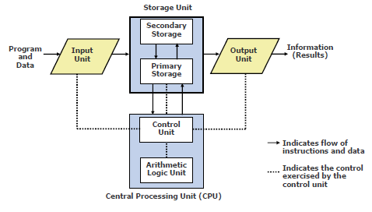
Basic organization of a computer system
Notes:
Input Unit:
• It accepts (or reads) instructions and data from outside.
• It converts these instructions and data in computer acceptable form
• It supplies the converted instructions and data to the computer system for further processing.
Central Processing Unit (CPU):
Control Unit:
Control unit of a computer system manages and coordinates the operations of all other components of the computer system.
Arithmetic Logic Unit(ALU):
Arithmetic logic unit of a computer system is the place, where the actual executions of instruction, takes place during processing operation.
Storage Unit:
Primary Memory: It is volatile ( loses data on power dissipation). It is used to hold running program instruction, data, intermediate results, and results of ongoing processing of jobs.
Secondary Memory:It is non-volatile (retains data even without power).It is used to hold stored program instructions and a large volume of information.
Output Unit:
• It accepts the results produced by the CPU.
• It converts these coded results to human acceptable form.
• It supplies the converted results to outside world.

Slide 7
Basic organization of a computer system
Storage Unit:
Primary Memory: It is volatile (Loses data on power dissipation). It is used to hold running program instruction, data, intermediate results, and results of ongoing processing of jobs.
Secondary Memory: It is non-volatile (Retains data even without power). It is used to hold stored program instructions and a large volume of information.

Slide 8
Arithmetic Logic Unit & Control Unit
Arithmetic Logic Unit of a computer system is the place where the actual executions of instructions takes place during processing operation
Control Unit of a computer system manages and coordinates the operations of all other components of the computer system

Slide 9
Central Processing Unit (CPU)
It is the brain of a computer system.
It is responsible for controlling the operations of all other units of a computer system

Slide 10
CPU (Cont…)
All computations take place here in order for the computer to perform a designated task.
It has a large number of registers which temporarily store data and programs (instructions).
It has functional units to carry out arithmetic and logic operations
It retrieves instructions from the memory, interprets (decodes) them, and performs the requested operation
Fetch → Decode → Execute cycle
CPU is also referred to as the processor

Slide 11
Classification of Software
Two categories:
Application Software
Used to solve a particular problem.
Editor, financial accounting, weather forecasting, etc.
System Software
Helps in running other programs.
Compiler, operating system, etc.

Slide 12
Operating Systems
A Program that controls the entire operation of a computer system. It is an interface between the hardware and the user.
Makes the computer easy to use.
Basically the computer is very difficult to use.
Understands only machine language.
Categories of operating systems:
Single user (MS-DOS)
Multi user (Linux, Mac OS, Windows)
Time sharing
Multitasking
Real time

Slide 13
What is a program?
A sequence of instructions that a computer can interpret and execute.
-If I tell you the way from Feni University to Feni College … I will tell you sequence of instructions…. Any wrong instruction leads you to a undesired result.

Slide 14
Programming Language
Three types of programming languages
Machine languages
Expressed in binary.
Directly understood by the computer.
Not portable; varies from one machine type to another.
-Program written for one type of machine will not run on another type of machine.
Difficult to use in writing programs.
Closer to Hardware
2. Assembly languages
English-like abbreviations representing elementary computer operations (translated via assemblers)
Example:
LOAD BASEPAY
ADD OVERPAY
STORE GROSSPAY

Slide 15
Programming Language (Cont..)
High-level languages
Codes similar to everyday English
Use mathematical notations (translated via compilers)
Example:
grossPay = basePay + overTimePay
High-level languages are easier to use.
-They are closer to the programmer.
-Examples:
Fortran, Cobol, C, C++, Java.
-Requires an elaborate process of translation.
Using a software called compiler.
-They are portable across platforms.

Slide 16
Evolution of Programming Languages
1883: The Journey Begins!!
In the early days, Charles Babbage had made the device, but he was confused about how to give instructions to the machine, and then Ada Lovelace wrote the instructions for the analytical engine.
The device was made by Charles Babbage and the code was written by Ada Lovelace for computing Bernoulli’s number.
First time in history that the capability of computer devices was judged.

Slide 17
Evolution of Programming Languages
1949: Assembly Language
It is a type of low-level language.
It mainly consists of instructions (kind of symbols) that only machines could understand.
In today’s time also assembly language is used in real-time programs such as simulation flight navigation systems.
It is also used to create computer viruses.
Notes:
The first computer virus, called "Creeper system", was an experimental self-replicating virus released in 1971. It was filling up the hard drive until a computer could not operate any further.
In January of 1986, the first virus written for Windows based PCs was born. Known simply as “Brain,” it was written by two brothers, Basit and Amjad Farooq Alvi, who were only 17 and 24 years old at the time.

Slide 18
Evolution of Programming Languages
1957: FORTRAN
Developers are John Backus and IBM.
It was designed for numeric computation and scientific computing.
Software for NASA probes voyager-1 (space probe) and voyager-2 (space probe) was originally written in FORTRAN 5.

Slide 19
Evolution of Programming Languages
1958: ALGOL
ALGOL stands for ALGOrithmic Language.
It was also the first language implementing the nested function and has a simple syntax than FORTRAN.
The first programming language to have a code block like “begin” that indicates that your program has started and “end” means you have ended your code.

Slide 20
C Language Overview
1972: C
The C programming language is a general-purpose, high-level language.
Originally developed by Dennis M. Ritchie at Bell Labs.
C was originally first implemented on the DEC PDP-11 computer in 1972.
In 1978, Brian Kernighan and Dennis Ritchie produced the first publicly available description of C, now known as the K&R standard.

Slide 21
C Language Overview (Cont..)
C was invented to write an operating system called UNIX.
C is a successor of B language, which was introduced around 1970.
In 1983 the American National Standards Institute (ANSI) formed a committee to establish a standard definition.
--Called ANSI Standard C.
The UNIX OS was totally written in C by 1973.
Notes:
ANSI C allows the inclusion of a function prototype which gives the type of the function and the type of each parameter before defining the function.

Slide 22
Why use C?
The C has now become a widely used professional language for various reasons.
Easy to learn
Structured Programming Language (SPL)
It produces efficient programs.
It can be compiled on a variety of computer platforms.

Slide 23
Why does C is called SPL?
The C has now become a widely used professional language for various reasons.
C is called structured programming language because while solving large and complex problem, C programming language divides the problem into smaller modules called functions.
Structured programming improves readability and quality of computer program by using smaller functions.

Slide 24
From HLL to executable
HLL (Source)
Program
Compiler
Linker
Object
Code
Executable
Code
Libraries

Slide 25
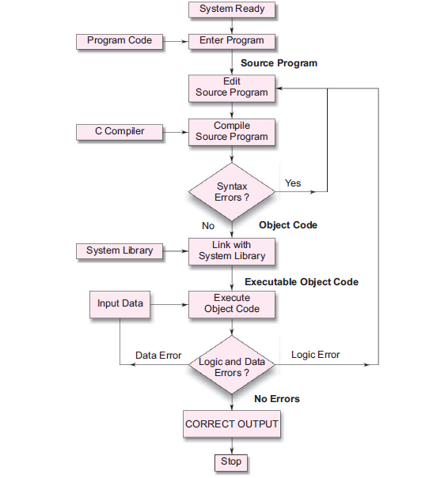

Slide 26
Some programmer jargon
Some words that will be used a lot:
Source code: The stuff you type into the computer. The program you are writing.
Compile (build): Taking source code and making a program that the computer can understand. It translates your source code (Hello.c) into object code (Hello.o)
Object Code: Object code generally refers to the output, a compiled file, which is produced when the Source Code is compiled with a C compiler.
Linker: A linker is special program that combines the object files, generated by compiler and other pieces of code to originate an executable file has .exe extension.

Slide 27
Some programmer jargon
Executable: After merging object code with other necessary files(i.e. header files) linker generates a .exe file that is executable.
Loader: It is special program that takes input of executable files from linker, loads it to main memory, and prepares this code for execution by computer. Loader allocates memory space to program.
Library: Added functions for C programming which are bolted on to do certain tasks.
Header file: Files ending in .h which are included at the start of source code.

